Slide 1
January 10, 2023
Principal PD

Slide 2
Aligning Our Work
https://docs.google.com/document/d/1BuN8K7gid2AAXvIH73xZihh035u6U8Gc9Cf2tLKtvTU/edit

Slide 3

Board Goal #1
Students are engaged and develop a strong academic foundation as measured by the following, overall and for historically underserved subgroups:
Mastery of English Language Arts (ELA) & Math foundational knowledge and skills by the end of 1st Grade, as measured by standardized assessments
ELA, Math, & Science proficiency rates in 3rd-8th grades, as measured by the Oregon Statewide Assessment System (OSAS)
ELA and Math growth rates in 4th-8th grades as measured by the Oregon Statewide Assessment System (OSAS)
The percent of 9th graders on track for graduation, as measured by credit attainment toward graduation requirements
The percent of students designated as English learners that are on track to acquire English proficiency, as measured by Oregon’s English Language Proficiency Assessment (ELPA)
Efficacy of academic programs, as measured by surveys and/or focus groups

Slide 4
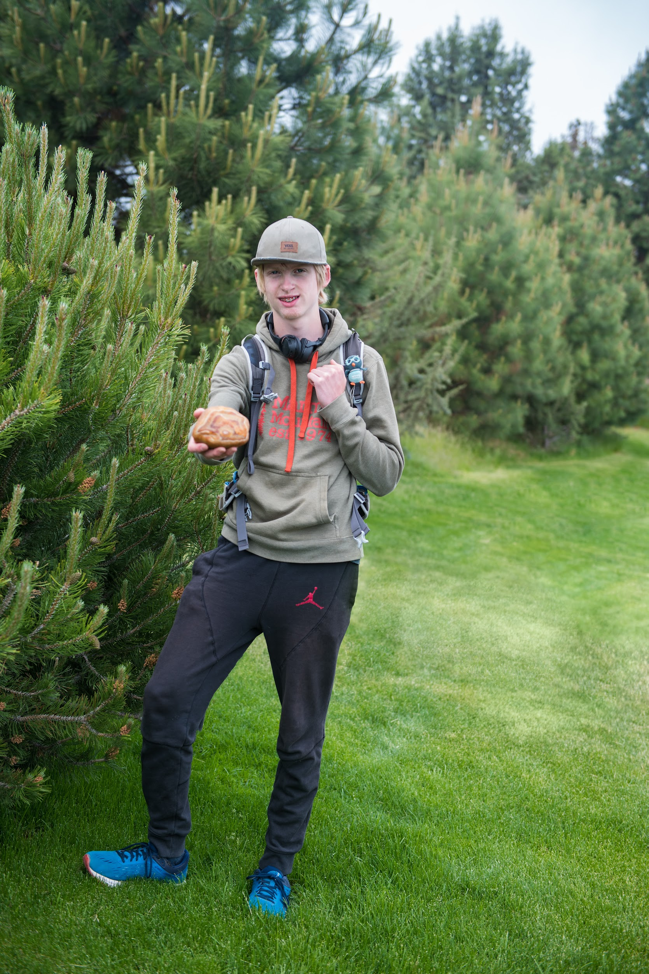
Board Goal #2
Students have a passion, purpose, and plan for their future as measured by the following, overall and for historically underserved subgroups:
The percent of high school students who graduate in four years, who graduate in five years, and who complete high school in five years.
The percent of graduates who earn a diploma plus complete at least one of the following career and life indicators:
  Two or more credits of Advanced Placement (AP), International Baccalaureate (IB), or college credit eligible coursework
  Oregon State Seal of Biliteracy
  Two years of Junior ROTC
  CTE Concentrator (Two or more credits in a program)
  Meets the college readiness benchmark for both language arts and mathematics on high school OSAS, ACT, or SAT assessments
  Meets automatic admission requirements for all Oregon Public Universities
Students’ preparedness for their future, as measured by surveys and/or focus groups.

Slide 5

Board Goal #3
Students, families, and staff experience wellness, inclusion, and belonging in our schools as measured by the following, overall and for historically underserved subgroups:
Student, family, and staff experiences of key elements of school culture (including voice, belonging, and emotional/psychological wellness), as measured by surveys and/or focus groups
Bias incident data and trends

Slide 6
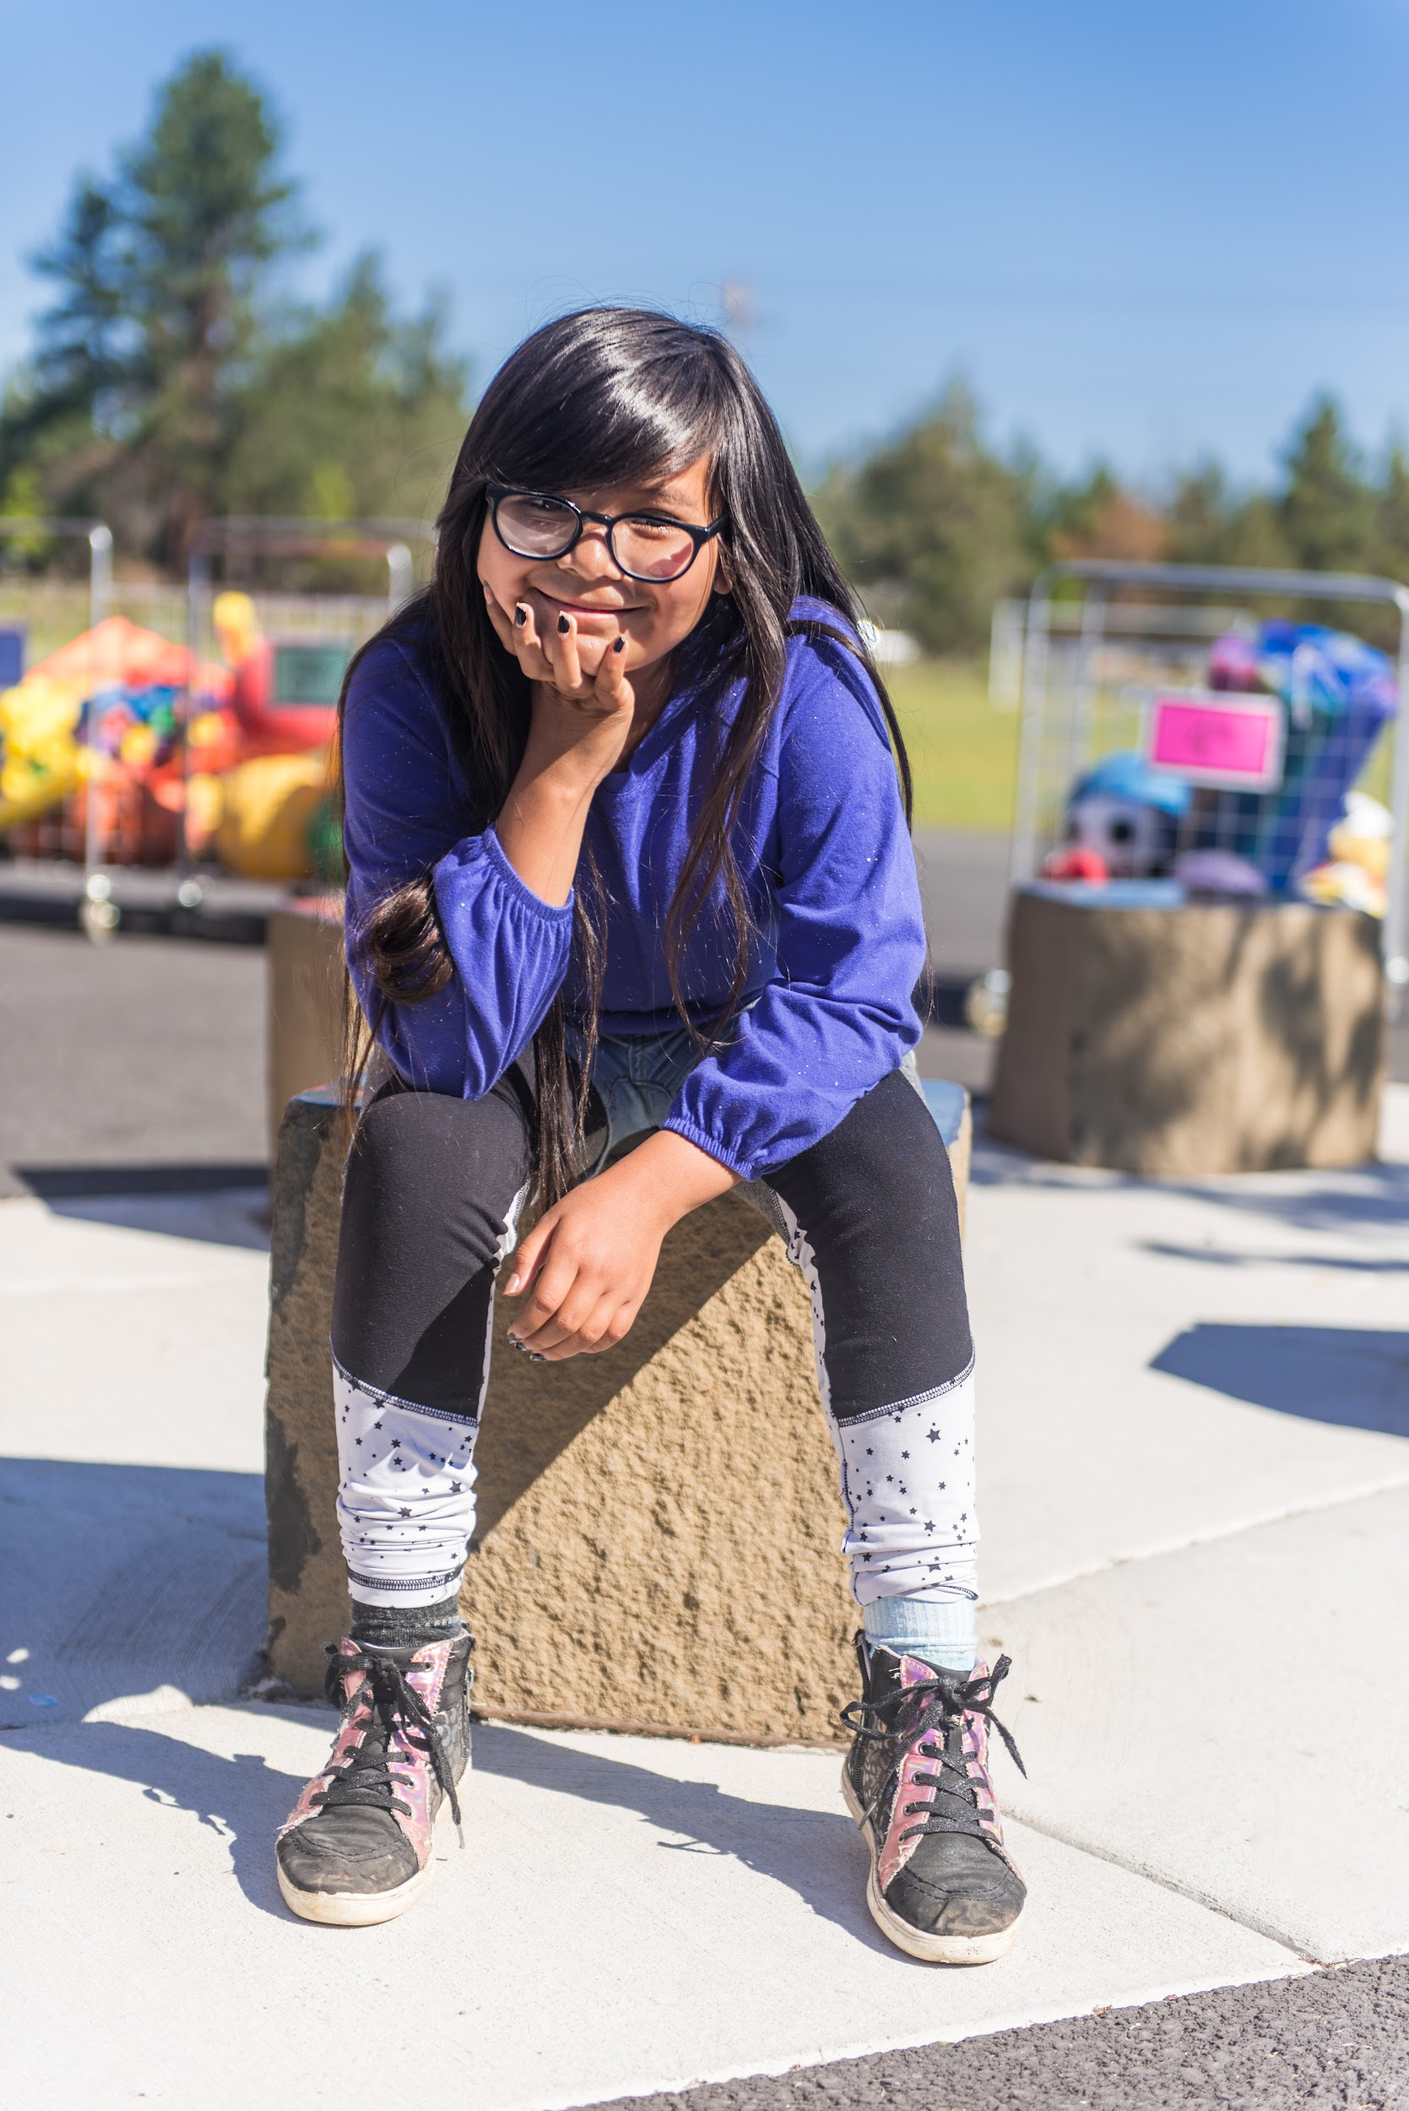
Board Goal #4
Operational systems align and support an academically effective and sustainable organization.
Link to approved document here.

