Slide 1
It’s Your Turn, It’s Your Choice
Teachers: Please check the notes for additional information.
Notes:
Teachers:
Look in notes on each slide for additional information

Slide 2
COVID-19 High School Vaccine Clinics
Nearly 4,000 local high school students from communities throughout Central Oregon will be eligible to take part in upcoming free vaccination clinics at local high schools, thanks to a regional partnership with local school districts, Mosaic Pediatrics, La Pine Community Health Center, St. Charles Health System, Deschutes County Health Services and Crook County Health Department.
Getting the vaccine is totally voluntary. Our School Based Health Centers are moving to campus for these events, but you can also get your vaccine at your physician's office and at mass vaccination sites like the Fairgrounds.

Slide 3
Learning Intentions
You will learn who is eligible for the COVID-19 vaccine.
You will learn about why you might want to get vaccinated.
You will learn dates/times/location and how to sign up.

Slide 4
Who is eligible to receive the COVID 19 Vaccine?
Beginning April 19, all Oregonians ages 16 and older are eligible to receive the COVID-19 vaccine. That includes students at our local high schools.
The FDA has approved the Pfizer vaccine for students 16-18.
The vaccine is free and you don’t need to show a driver’s license, proof of insurance or social security number.
Notes:
Teachers:
Here is additional information to help answer student questions.
BLS Frequently Asked Questions about HS Based Vaccine Clinics
https://drive.google.com/file/d/1EzWQYbjXql0dZ8kWVlcukPQyhLaAGZ_7/view?usp=sharing
Student Letter
https://docs.google.com/document/d/1OAuSVWWNqM_WumQFfWe_8-_LNmHKvF2Nb5nc-ojTqFk/edit?usp=sharing
Parent Letter
https://docs.google.com/document/d/1Ksq0sP_sjMOIAfCO0Tq0yIj5xOVz_sZw6JsyOPpObk0/edit?usp=sharing

Slide 5
Why get vaccinated?
According to the CDC, getting vaccinated helps keep you, and those around you, safer.
Safely spend time with those you care about
Just as with adults, the Oregon Health Authority says that fully vaccinated students (both doses) without COVID-19 symptoms will not have to be quarantined if exposed to the virus.
This gives you the ability to remain in:
Classes
Athletics
Activities
Notes:
Additional notes:
Vaccination is the safest, most effective, and most reliable way to keep yourself, your family, and your community healthy and safe from COVID-19.
Vaccines don’t just protect you, but the people around you as well. When enough people are vaccinated germs can’t travel as efficiently and the entire community, including vulnerable populations and those who cannot get vaccinated are less likely to get sick.
At 95 percent efficacy, this vaccine is extraordinarily effective at protecting you.
Getting a COVID-19 vaccine is the best tool we have to help us end the COVID-19 pandemic
The vaccines protect you from getting COVID-19 and from getting seriously ill if you do get the virus.
The COVID-19 vaccines are safe and effective, and once enough people in Oregon are vaccinated we can get back to the people, places, and things we love.
If you get COVID-19, you also risk giving it to loved ones who may get sick. Getting a COVID-19 vaccine is a safer choice.

Slide 6
Is it my choice?
The vaccine is voluntary.
Though Oregon law says you don’t need permission if you are over 16 to receive the vaccine, we encourage you to discuss this opportunity with family.
The vaccine is not required to attend school.
Not everyone will want to get the vaccine, some will get it this week and some will have already received it. Getting vaccinated is a person’s choice that we should all honor.
Notes:
Teacher notes:
The vaccine is not required to attend school and is completely voluntary. It’s your choice, but fully immunized students will no longer need to quarantine if exposed to the virus. It will also help minimize spread or outbreaks in our school, and allow students to stay involved in sports and other school activities. Masks are still required at school even if you’ve been vaccinated.

Slide 7
Is it safe?
The CDC says the Pfizer vaccine is safe and effective. The Food & Drug Administration (FDA) requires rigorous safety testing before it will authorize any vaccine. The COVID-19 vaccine from Pfizer was tested in thousands of study participants and generated enough data to convince the FDA that the vaccine was safe and effective.
Learn more about the vaccine: Pfizer COVID-19 vaccine.
Notes:
Teachers:
Pfizer’s COVID-19 vaccine, which is 95% effective against COVID-19 infection. The change in age was recently approved by the Food and Drug Administration (FDA).
The Food and Drug Administration (FDA) requires rigorous safety testing before it will authorize any vaccine. The COVID-19 vaccine from Pfizer was tested in thousands of study participants and generated enough data to convince the FDA that the vaccine was safe and effective.

Slide 8
Are there side effects?
Most people develop some soreness at the injection site. Fatigue and headache are common.
Less common are muscle aches, chills, joint pain, vomiting, or fever.
Most side effects resolve after a day or two.
Learn more about the vaccine.
Notes:
Distribute electronically or via paper, the Pfizer Fact Sheet.

Slide 9
What precautions will be taken related to allergies and potential adverse vaccine reactions?
Students will be asked to complete a form highlighting allergies and other reactions prior to receiving the vaccine. Medical providers will be onsite to provide private counsel to students, if needed.

Slide 10
What emergency response protocols will be used?
In the unlikely event that a student experiences an adverse vaccine reaction, one of the several medical providers onsite will respond with emergency supplies. If deemed necessary, EMS will be called in the extremely unlikely event that the reaction cannot be treated onsite.

Slide 11
How are the vaccine clinics adhering to the State law of Minor consent?
Students will be asked to complete a consent to treat form which includes a description of the treatment the patient will receive, a description of alternative treatments and a description of any risks involved with the treatment. At the vaccine clinics, students will be provided with information verbally and in writing on the Pfizer vaccine prior to their opportunity to schedule vaccination appointments. Materials used include collateral from the CDC (“Pfizer Fact Sheet”), addressing risks and benefits of choosing to receive the vaccine. All students who wish to receive the vaccine must first complete necessary registration forms, including Consent to Treat and HIPAA (Health Insurance Portability and Accountability Act) Notice of Privacy Practice forms. Each student will be supported one-on-one in this process by a Patient Registration Representative. In the State of Oregon, minors who are 15 years or older are able to consent to medical and dental services without parental consent. (ORS 109.640). Students will also be provided with information about an online tool for reporting any side effects after getting the COVID-19 vaccine (“V-Safe Flyer”).

Slide 12
What about wearing a mask?
All students and staff must wear masks in school regardless of their vaccination status.
Notes:
Teacher notes:
State guidance indicates that anyone who is completely vaccinated (two weeks after their second dose of vaccine), and is not symptomatic, no longer needs to quarantine if exposed to a positive case of COVID-19.

Slide 13
Have a conversation
Families are encouraged to discuss vaccinations and make a decision about their student’s participation together, and to learn more about vaccines through trusted sources such as the CDC, Oregon Health Authority, or their doctor.
Also understand and talk to your family about consent.
Notes:
The consent to treat and the documents referenced are generally hard copies that we have patients sign when they register. At the clinic, students will get a small packet which will include the two documents you had attached.
Consent is an acknowledgement (usually in writing) of any or all of the following:
• The patient understands the treatment he/she will receive.
• The patient authorizes the treatment.
• The patient understands how private information will be shared.
All consent should be informed consent (ORS 677.097). Informed consent for health services should be verbal or in writing and includes: a description of the treatment the patient will receive, a description of alternative treatments and a description of any risks involved with the treatment.
At Mosaic-administered vaccine clinics students will be provided with information verbally and in writing on the Pfizer vaccine prior to their opportunity to schedule vaccination appointments.

Slide 14
When can I get my vaccine?
Clinics will be scheduled before, during and after school hours and will take place in school gymnasiums.
Bend Senior High School: April 29 and May 20
  Vaccine appointments will be open from 8 a.m. - 5 p.m.
La Pine High School: May 6 and May 27
  Vaccine appointments will begin at 10 a.m.
Mountain View High School: May 4 and May 25
  Bend Tech Academy at Marshall, Realms High School, Skyline High School invited to attend
  Vaccine appointments will be open from 8 a.m. - 5 p.m.
Summit High School: May 6 and May 27
  Vaccine appointments will be open from 8 a.m. - 5 p.m.

Slide 15
When can I get my vaccine?
You can also receive a vaccine at these locations:
Pre-register for an appointment at the Central Oregon Mass Vaccine Clinic at www.centraloregoncovidvaccine.com.
Crook County vaccine clinic information
Deschutes County vaccine clinic information
Jefferson County vaccine clinic information
Fred Meyer pharmacies
Find appointments at local pharmacies: www.vaccinefinder.org
Current Mosaic Medical patients may schedule here
La Pine Community Health Center patients may schedule here.

Slide 16
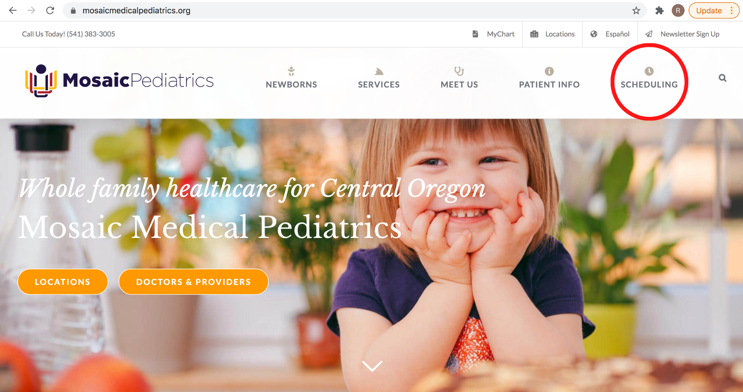
How do I sign up?
Step 1: Visit mosaicmedicalpediatrics.org and click on “scheduling.”

Slide 17
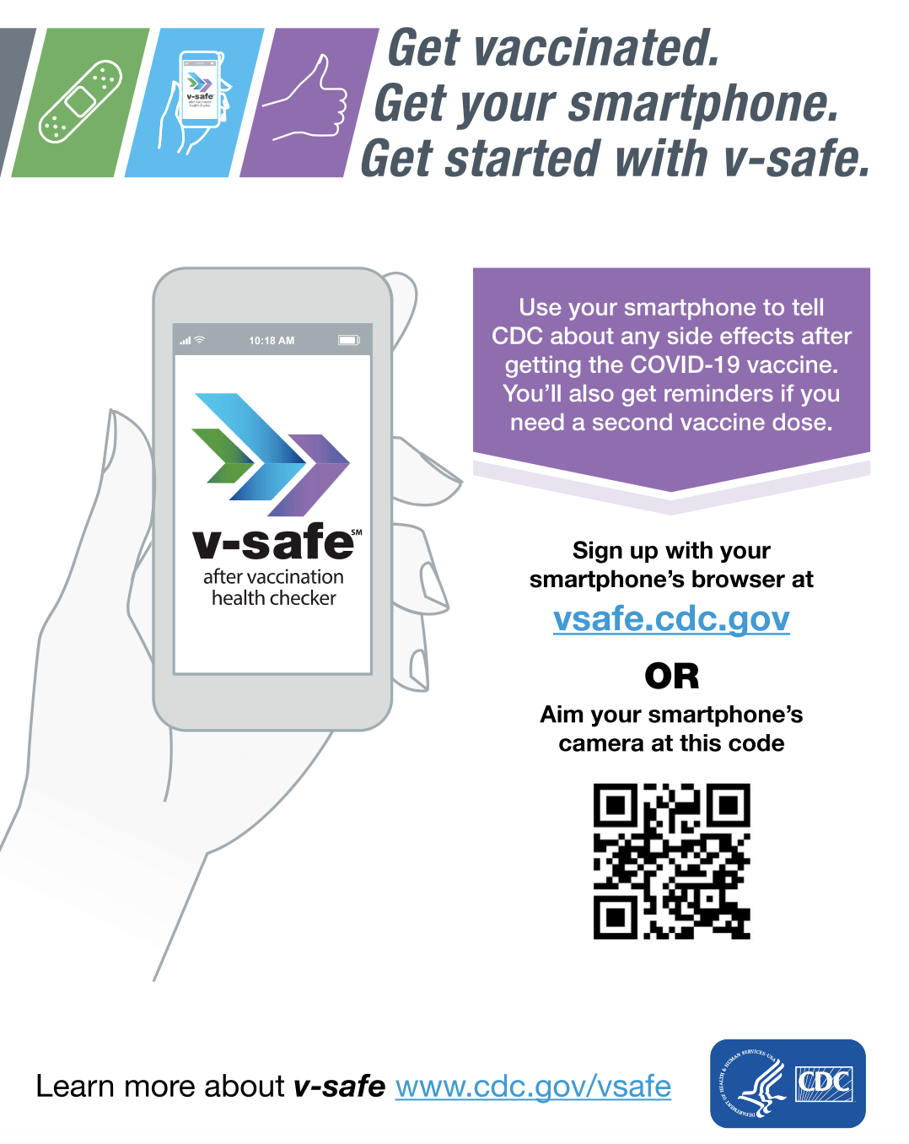
After the vaccine?
Use the v-safe app to get a reminder for your next vaccination and to track any symptoms that you may have.
Learn more at vsafe.cdc.gov

